Slide 1


Robert Fenney
13 February, 2025

Slide 2

Outline
Executive Summary
Introduction
Methodology
Results
Conclusion
Appendix

Slide 3
Executive Summary
Summary of methodologies: We performed comprehensive data wrangling and feature engineering from cleaned SpaceX launch records. The analysis leveraged detailed visuals and interactive maps to dynamically present spatial and numerical insights.
Summary of all results: We discovered significant patters like distinct clustering of launch outcome markers and clear proximity trends between launch sites and key geographical features (e.g., coastlines, cities, highways). These findings, combined with predictive analysis on launch success factors (e.g., payload mass, flight number), provided a robust technical narrative that informs both operational assessments and strategic decision-making for peers.

Slide 4
Introduction
Project Background & Context
SpaceX’s innovative reusability practices have revolutionized space exploration by significantly reducing launch costs.
We gathered and cleaned comprehensive datasets containing details such as launch dates, payload masses, launch sites, and outcomes.
Using a mix of Python tools (Pandas, Matplotlib, Folium, SQL, and more), we delved into both the geographical and technical aspects of these launches.
Specific Problems We Addressed
Launch Success Trends: How does the success rate evolves over time, and which launch sites demonstrate higher success rates?
Geographical Influences: Does the proximity of launch sites to key geographical features (e.g., coastlines, railways, and urban centers) correlates with higher success?
Outcome Patterns: What patterns emerge from the dataset regarding successful and failed launches?
Predictive Analysis: How can we build a machine learning pipeline to predict if a Falcon 9 first stage will land successfully based on historical data?

Slide 5

Section 1

Slide 6
Methodology
Executive Summary
Data collection methodology:
We gathered the data via web scraping and API queries, extracting comprehensive launch records from SpaceX’s online resources
Perform data wrangling
The raw launch data was cleaned, enriched, and transformed using Python (Pandas and SQL) to create an analysis-ready dataset
Perform exploratory data analysis (EDA) using visualization and SQL
Perform interactive visual analytics using Folium and Plotly Dash
Perform predictive analysis using classification models
We built, tuned, and evaluated classification models using cross-validation and hyperparameter adjustments to predict Falcon 9 landing outcomes

Slide 7
Data Collection
Our datasets were collected by combining two main approaches: fetching raw SpaceX launch records via API calls and performing web scraping from SpaceX web pages. Both sources were then cleaned and merged to create a rich, analysis-ready dataset.
Data Collection process overview:
API Extraction
(SpaceX API Data)
Removed errors
Handled missing values
Format conversions, filtering
Data Sources
Data Cleaning, Transformation, and Enrichment
Data Storage
(CSV, Database, etc.)
Ready for Analysis & Model
Combined Raw Data
Web Scraping

Slide 8
Data Collection – SpaceX API
Data collection with SpaceX REST calls flowchart to the right
Github URL: https://github.com/TheRobertFenney/IBM_DataScience_Capstone/blob/main/module%201/jupyter-labs-spacex-data-collection-api.ipynb
1. SpaceX API Endpoint
(GET Request Sent)
2. JSON Response Data
(Raw Launch Records)
3. Data Parsing & Cleaning
(JSON to DataFrame)
4. Data Storage (CSV Export)

Slide 9
Data Collection - Scraping
1. Identify Target Web Pages
Web Scraping flow chart to the right
Github URL Here
2. HTTP Request & Page Retrieval
3. Parse HTML & Extract Data
4. Clean & Transform Extracted Data
5. Integrate & Store Data

Slide 10
Data Wrangling
1. Data Ingestion
After collecting the raw data from various sources (API and web scraping), we perform data wrangling to transform this semi-structured information into an analysis-ready, structured format. This involves normalizing the JSON structures, cleaning the data, and integrating multiple datasets.
Github URL here
2. JSON Normalization
3. Data Cleaning
4. Data Transformation
5. Data Integration
6. Data Export

Slide 11
EDA with Data Visualization
Charts Used and Why:
Line Chart: Visualizes Launch Success Rate by Year
Histogram: Visualizes Distribution of Categorical Outcomes
Scatter Plot: Visualizes Correlation between Payload Mass and Success
Box Plot: Visualizes Distribution and Outliers in Continuous Data
GitHub URL here

Slide 12
EDA with SQL
Retrieve a Sample of Records:
- SQL Query: SELECT * FROM spacex_launches LIMIT 10;
- Purpose: Quickly verify data ingestion by inspecting the first few rows.
Average Success Rate by Year:
- SQL Query: SELECT EXTRACT(YEAR FROM Date) AS Year,
AVG(CASE WHEN Outcome LIKE '%Success%' THEN 1 ELSE 0 END) AS SuccessRate
FROM spacex_launches GROUP BY Year ORDER BY Year
- Purpose: Analyze trends over time by determining what percentage of launches were successful each year.
Launch Site Analysis:
- SQL Query: SELECT LaunchSite, Count(*) AS LaunchCount, AVG(CASE WHEN Outcome Like `%Success%` THEN 1 ELSE 0 END) AS SuccessRate
-FROM spacex_launches Group BY LaunchSite ORDER BY LaunchCount DESC
- Purpose: Assess which launch sites are used most frequently and how their success rates compare.
Payload Mass Statistics by Orbit
SQL Query: SELECT Orbit, MIN(PayloadMass) AS MinPayload, MAX(PayloadMass) AS MaxPayload, AVG(PayloadMass) AS AvgPayload FROM spacex_launches GROUP BY Orbit;
Purpose: Compare payload mass distributions across different orbit types to spot trends and anomalies.
Booster Version Frequency:
SQL Query: SELECT BoosterVersion, COUNT(*) AS LaunchCount FROM spacex_launches GROUP BY BoosterVersion ORDER BY LaunchCount Desc;
Purpose: Determine which booster versions are most used and how they might be related to launch outcomes.
Identifying Non-Successful Launches:
SQL Query: SELECT * FROM spacex_launches WHERE Outcome NOT LIKE `%Success%`
Purpose: Isolate and review launches that did not end in success to further investigate potential issues.
GitHub URL

Slide 13
Build an Interactive Map with Folium
On the folium maps, we added Markers, Circles, Lines, and Interactive Enhancements to allow us to transform raw geographic data into an interactive visual narrative.
Markers
- Markets pinpoint exact geographic coordinates on the map, used to denote specific ROI.
Circles
- Draw circular overlays on map to designate ROIs.
Lines
- Used to connect multiple points to depict flight paths, trajectories, or routes.
Interactive Enhancements (Popups and Tooltips)
- Offer concise, on-demand information without cluttering the map. Offers information when interacted with.
GitHub URL Here

Slide 14
Build a Dashboard with Plotly Dash
We added:
Dropdown: Allows the user to select specific launch sites
Pie chart: displays total successful launches for all sites, as well as success vs failure rates
Range Slider: Enables payload mass filtering for scatter plot
Scatter plot: Displays payload vs launch outcomes based on booster versions
Github URL Here

Slide 15
Predictive Analysis (Classification)
To identify the best performing model, we split the dataset into training and test sets and built candidate classification models for K-Nearest neighbor, Logistic Regression, SVM, and Decision tree algorithms.
We tuned the hyperparameters using cross-validation and compared the cross-validation scores from different models.
GitHub URL HERE
1. Data Collection & Preprocessing
2. Exploratory Data Analysis
3. Feature Engineering
4. Model Building (Train-Test Split, X & Y)
5. Model Evaluation (CV, Confusion Matrix, etc.)
6. Model Improvement (Hyperparameter Tuning)
7. Final Model Selection & Prediction

Slide 16
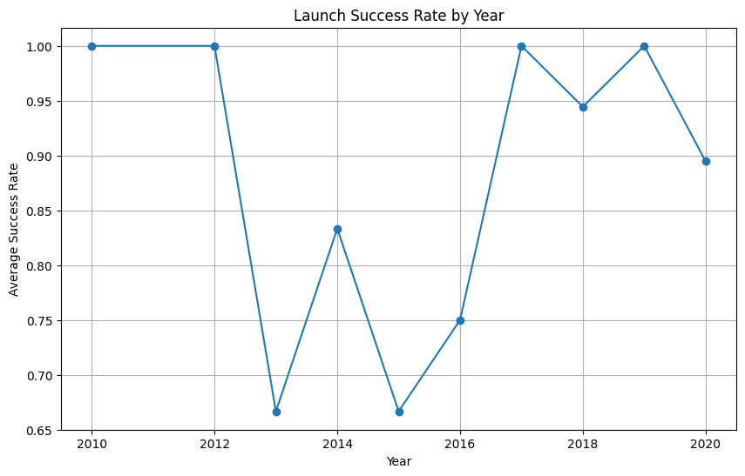
Results
Launch Success Evolution
Success rate improved significantly from 2013-2017
Notable improvement after 2015
Stabilized during 2014
Orbit Type Analysis
Different success rates for different orbits
LEO, ISS, Polar orbits showed higher success rates
GTO missions showed mix results
Landing Outcome Classification
Approximately 67% success rate overall

Slide 17

Section 2

Slide 18
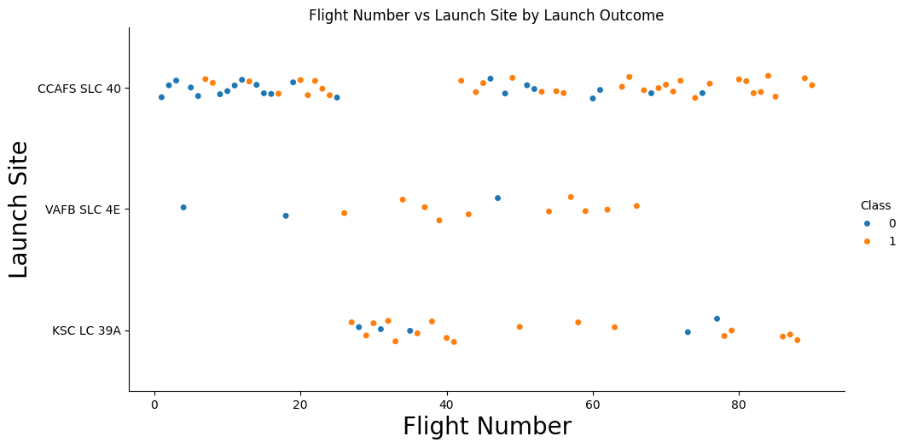
Flight Number vs. Launch Site
0 denotes failure, 1 denotes success
Flights are highly concentrated on the CCAFS SLC 40 site
You can see a marked improvement on the first sight overtime, reflected across the other sites.

Slide 19
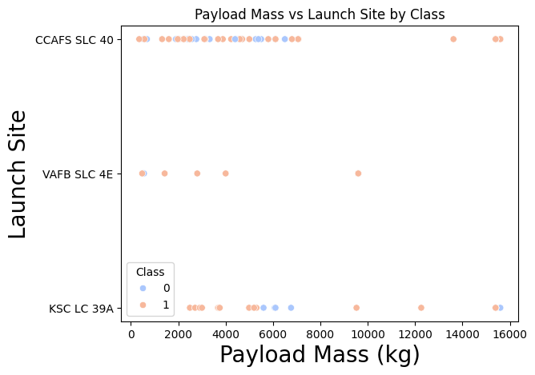
Payload vs. Launch Site
Payload Mass vs Launch Site by Class is seen on the right
Most launches are under the 7000 kg range
CCAFS SLC 40 has most of their launches between 2000-6500

Slide 20
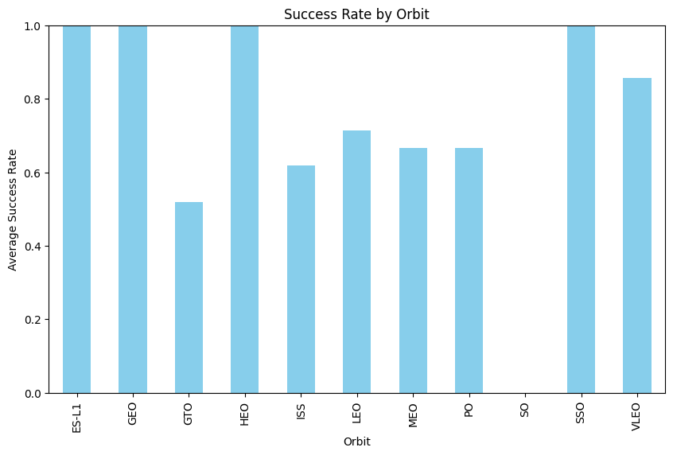
Success Rate vs. Orbit Type
ES-L1, GEO, HEO, and SSO all have 100% success rates for missions
The lowest success rate is GTO at 50%
Interestingly, 4 failures seem to hover within the 60-70% range.

Slide 21
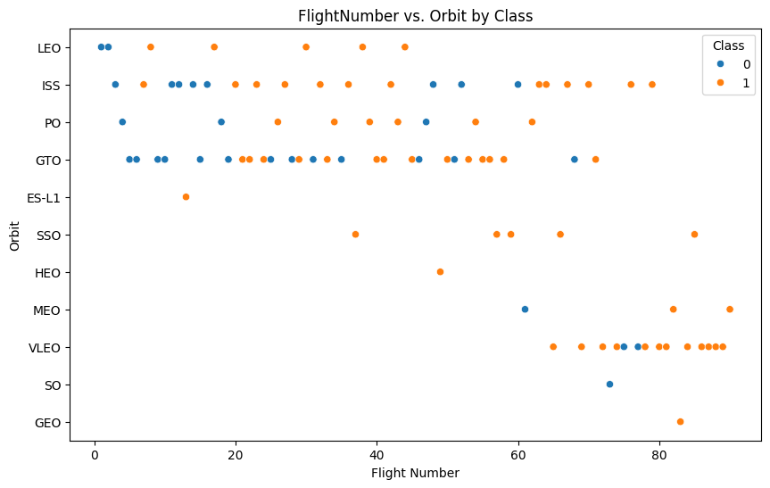
Flight Number vs. Orbit Type
Early launches were plagued with failures, but as launches go on the success rate improved.
GTO and ISS both seem to have inconsistent success rates.
You can see the progression of SpaceX trying new orbital type missions as they progress with the flight numbers.

Slide 22
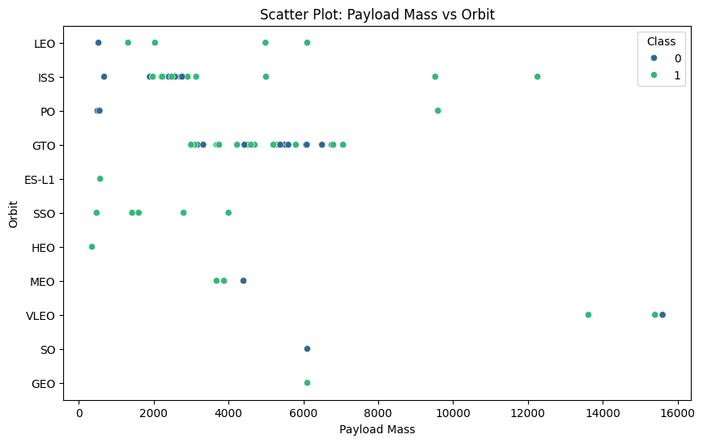
Payload vs. Orbit Type
There doesn’t seem to be any correlations between payload mass and orbital type mission success or failure.

Slide 23
Launch Success Yearly Trend
There’s a dip from 2013-2016 of lower missions success rates between 66%-83%.
Launches succeeded after that point though, indicating they fixed whatever the issue was.

Slide 24
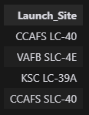
All Launch Site Names
You can see four Unique Launch Sites exist in the data we used

Slide 25
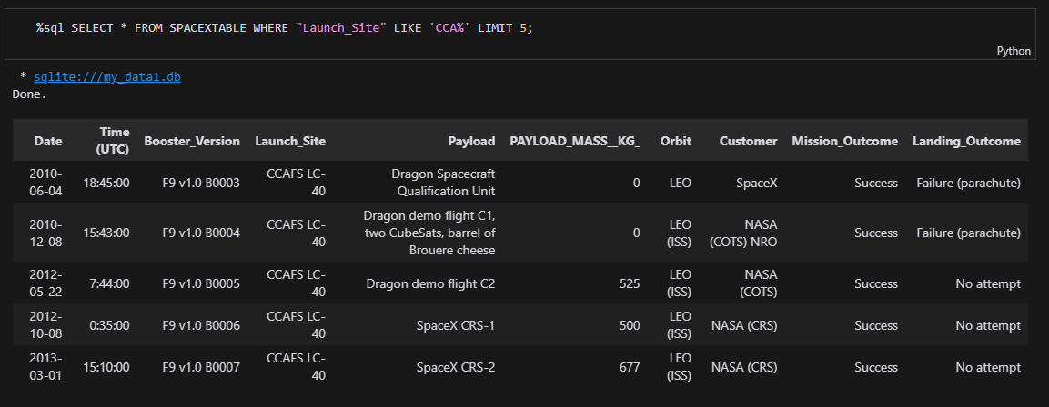
Launch Site Names Begin with 'CCA'
You can see below five records with launch sites beginning with CCA:

Slide 26
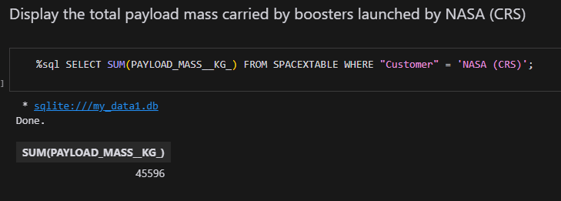
Total Payload Mass
Sum Payload carried by boosters launched by NASA was 45596 KG:

Slide 27
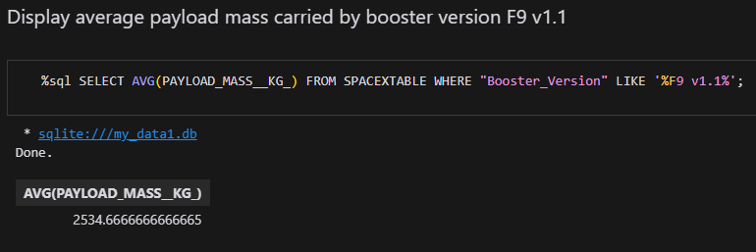
Average Payload Mass by F9 v1.1
Average Payload carried by booster version F9 v1.1 was ~2534KG

Slide 28
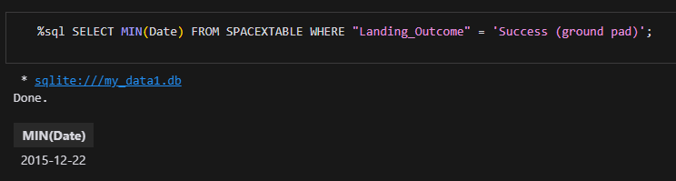
First Successful Ground Landing Date
First successful landing was on 2015-12-22

Slide 29
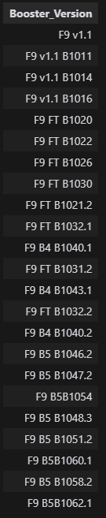
Successful Drone Ship Landing with Payload between 4000 and 6000
To the right is a list of all successful drone ship landings with
With payloads between 4-6K.

Slide 30
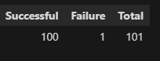
Total Number of Successful and Failure Mission Outcomes
Majority of missions were successful, with only one failure out the of the 101 missions in total.

Slide 31
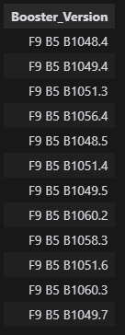
Boosters Carried Maximum Payload
To the right you can see the boosters that carried the
maximum payload.

Slide 32
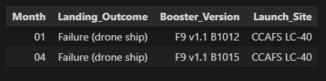
2015 Launch Records
You can see all failure outcomes below with their corresponding booster versions and launch sites:

Slide 33
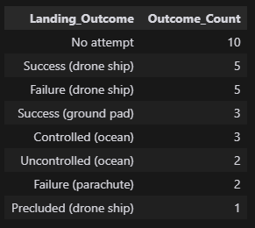
Rank Landing Outcomes Between 2010-06-04 and 2017-03-20
Here you can see the count of landing outcomes (such as Failure (drone ship) or Success (ground pad)) between the date 2010-06-04 and 2017-03-20, in descending order

Slide 34

Section 3

Slide 35
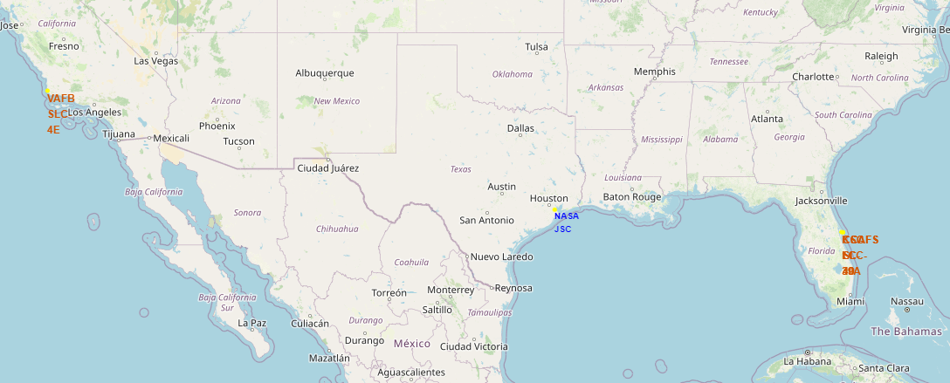
Launch Site Locations
Four launch sites located below, 3 on East coast, 1 on West coast. (Houston marker is just to indicate initial center of map)

Slide 36
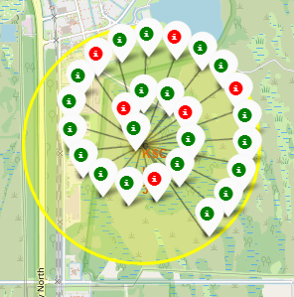
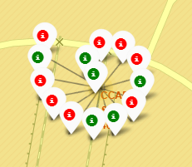
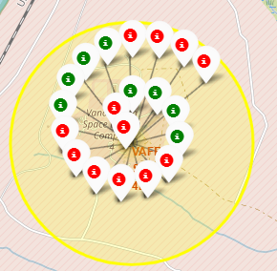
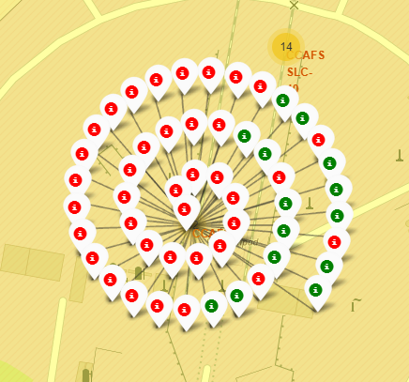
Mission Outcomes by Launch Site
Most Successful launches ->
^Most launches

Slide 37
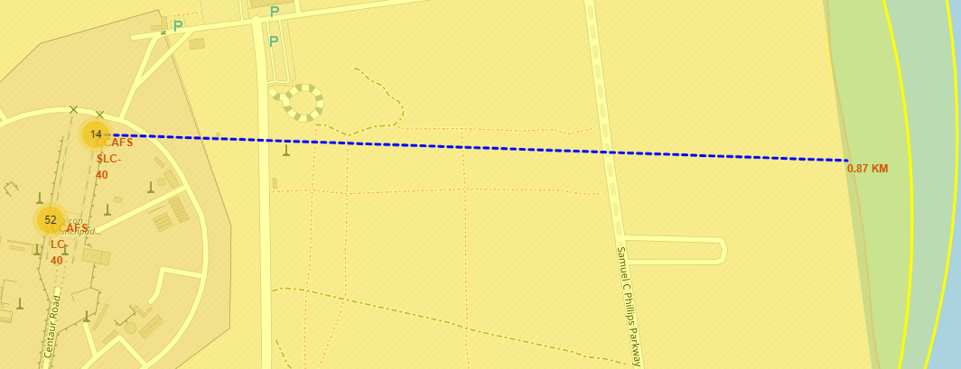
Site Distance from Coastline
Site CCAFS SLC-40 is .87Km away from the coastline

Slide 38

Section 4

Slide 39
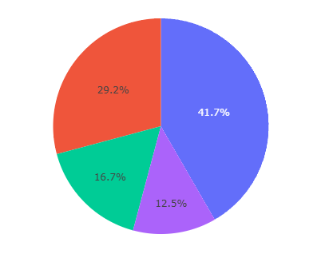
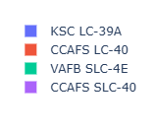
Total Successful Launches by Site
KSC LC-39A: 10
CCAFS LC-40: 7
VAFB SLC-4E: 4
CCAFS SLC-40: 3

Slide 40
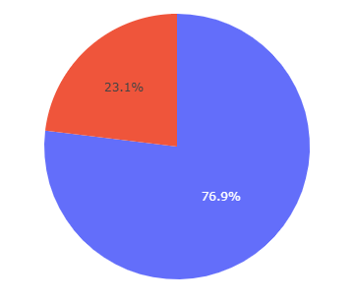
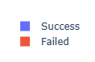
Launch Outcomes for KSC LC-39A (Highest Success %)
KSC LC-39A had a 76.9% Launch Outcome success rate, putting it highest out of any other site.

Slide 41
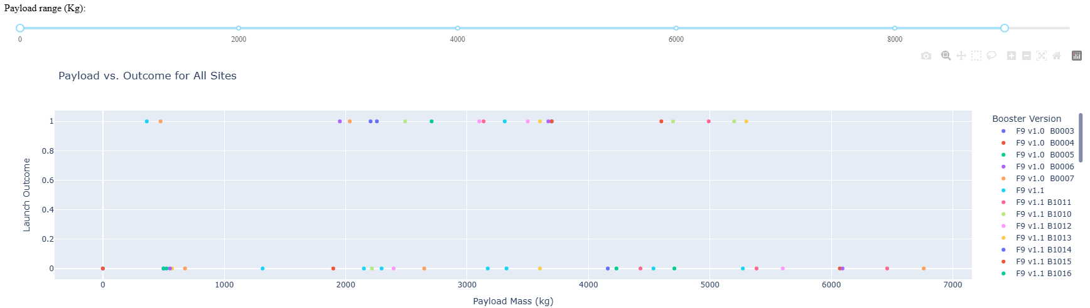
Payload vs. Outcome for all sites
There’s no correlation between Payload and outcome, regardless of model number or payload outcome is dependent on more than these factors.

Slide 42

Section 5

Slide 43
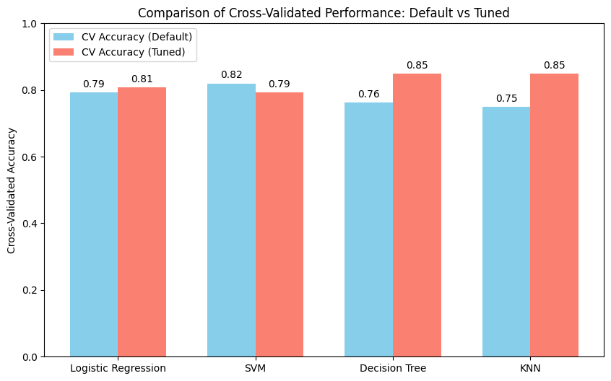
Classification Accuracy
To the right you can see that Decision Tree and KNN are both pretty close, but KNN actually wins at 84.82%.
Overall hypertuning was valuable, raising ¾ of the methods.
Particularly visible for Decision Tree and KNN.

Slide 44

KNN Confusion Matrix
This is the KNN Confusion Matrix,
Which performed the best at 84.8%.
We had 3 TN, 3FN, 12TP. We didn’t have any FP.

Slide 45
Conclusions
The success rate of SpaceX launches improved significantly over time, showing an upward trend from 2013 to 2017, with improvement after 2015. This suggests continuous technological advancement and learning from previous missions.
Between 2010-06-04 and 2017-03-20, the landing outcomes were distributed as follows:
No attempt: 10 cases
Success (drone ship & ground pad combined): 8 cases
Failure (various types): 7 cases
This shows a gradual transition from no landing attempts to more successful recoveries.
The payload mass ranged from 20 kg to 15,600 kg with a mean of approximately 5,919 kg, demonstrating SpaceX's capability to handle a wide range of payload sizes.
The overall success rate of missions was approximately 67% (0.6666666666666666), indicating that two-thirds of all missions achieved their intended outcomes.

Slide 46
Appendix
https://github.com/TheRobertFenney/IBM_DataScience_Capstone

Slide 47


